Slide 1

Physical Activity Analysis
By Manish K

Slide 2
Content
Data Overview
Activity Pattern
Time Series Analysis
Insights and Implications

Slide 3
Section 1
DATA OVERVIEW

Slide 4
Activity Levels
01
02
03
Various Levels
The dataset reveals different levels of physical activity, including very active, moderately active, lightly active, and sedentary. This categorization helps in understanding the intensity and type of activities performed by individuals.
Steps and Distance
The focus is on the total steps taken and the total distance covered. The highest recorded steps and distance in the dataset are 23,186 steps and 20.4 km, respectively, indicating significant physical exertion by some individuals.
Caloric Burn
The analysis suggests a correlation between the number of steps taken and calories burned. It indicates that people burn approximately 2000 to 3000 calories for every 5k to 15k steps, providing a measure of the energy expenditure associated with different levels of activity.

Slide 5

VISUALIZATION
Correlation Matrix
The heatmap generated by sns.heatmap() would show the relationships between different numerical variables. Although the exact correlations are not provided in the text, this step is crucial for understanding how different activity metrics relate to each other.
Distribution of TotalSteps
The sns.histplot() visualization would help identify the distribution of steps, which is important for assessing the range and commonality of activity levels.
Relationship between TotalSteps and Calories
The sns.scatterplot() visualization would illustrate the relationship between steps and calories, providing insights into the energy expenditure associated with different activity levels.

Slide 6
Section 2
ACTIVITY PATTERN

Slide 7
Activity Levels
01
02
Data Structure
The dataset is a large DataFrame with over 3.7 million entries, indicating extensive tracking of activity over time. It includes columns for Id, ActivityMinutes, Calories, Intensity, METs, and Steps.
Statistical Summary
The .describe() method reveals insights into the average calories burned per minute, the mean METs value, and the distribution of steps, providing valuable information about activity habits.

Slide 8

Outlier and Distribution
Outliers and Distribution
The sns.boxplot() and sns.histplot() visualizations would help identify outliers in METs and the distribution of steps, respectively, which are important for assessing the range and commonality of activity levels.

Slide 9
Section 3
TIME SERIES ANALYSIS

Slide 10
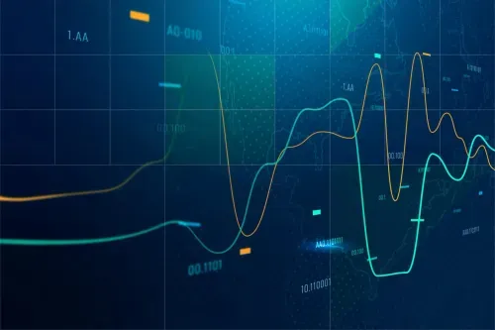
Trends Over Time
Time Series Analysis
The sns.lineplot() visualization likely illustrates trends or patterns in steps and calories over time, which can be valuable for understanding activity habits.

Slide 11
Section 4
INSIGHTS AND IMPLICATIONS

Slide 12

Trends Over Time
Activity Patterns
These insights can help in understanding individual or group activity patterns, evaluating the intensity and effectiveness of workouts, and possibly in designing personalized fitness plans based on the data trends observed.

Slide 13

Recommendations
Fitness Plans
The insights from the data can inform the design of personalized fitness plans based on individual activity patterns and energy expenditure.

Slide 14

Conclusion
Summary
The analysis provides valuable insights into physical activity patterns, energy expenditure, and the relationship between different activity metrics. These insights can be used to inform fitness plans, evaluate the effectiveness of workouts, and understand individual or group activity patterns.

Slide 15
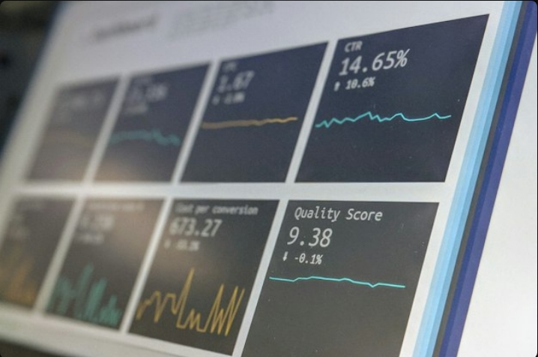
Conclusion
Further Analysis
Future research could involve deeper analysis of specific activity patterns, the impact of different types of exercise on energy expenditure, and the design of personalized fitness plans based on individual activity habits.

Slide 16
Thank you

